Slide 1
Lecture No. 44
At the end of this Lecture , student will be able to:
Discuss the orientation of graphene
Explain top-down and bottom-up approach of nanomaterial synthesis
Outline the chemical vapour deposition method of synthesis of nano materials
Application of graphene- polymer nanocomposite

Slide 2
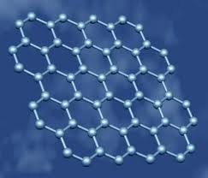
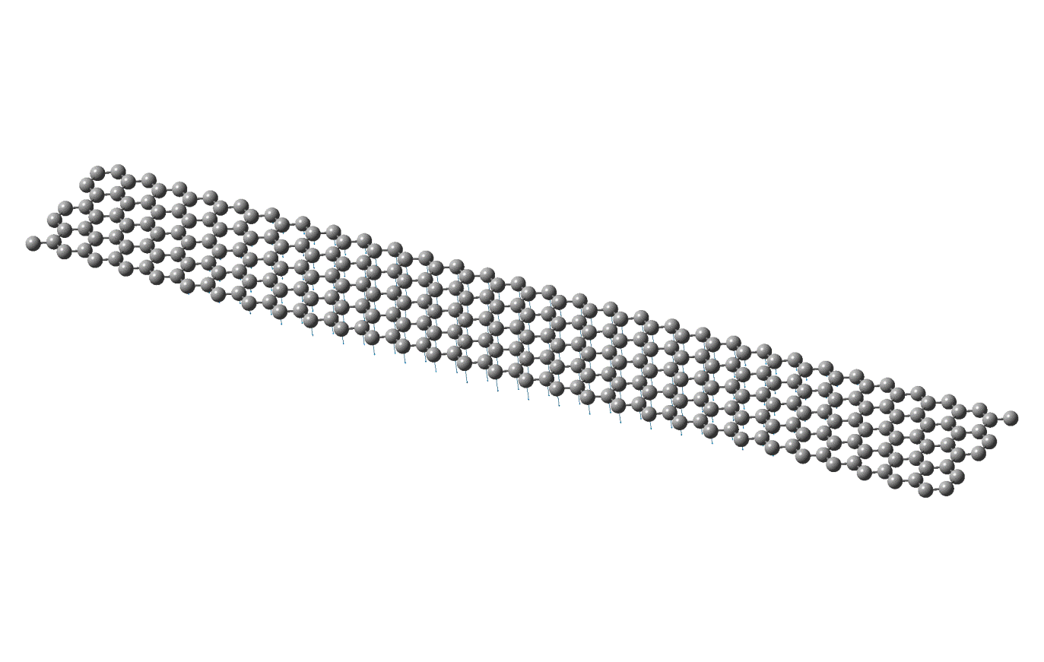
Graphene
Graphene is defined as a one atom thin sheet of carbon atoms arranged in a Hexagonal format or a flat monolayer of carbon atoms that are tightly packed into a 2D honeycomb lattice

Slide 3
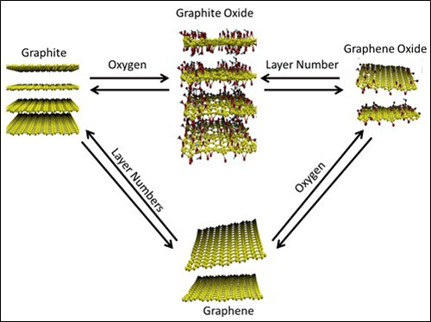
Graphene
Graphene is a one-atom-thick sheet of carbon whose strength, flexibility, and electrical conductivity have opened up new horizons for high-energy particle physics research and electronic, optical, and energy applications

Slide 4
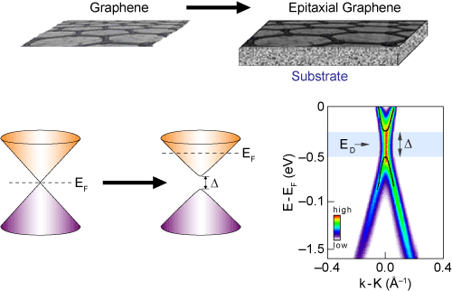
Properties of graphene depend on the substrate

Slide 5
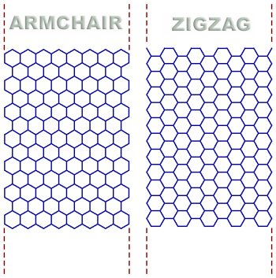
Geometry of graphene may also affect the properties

Slide 6
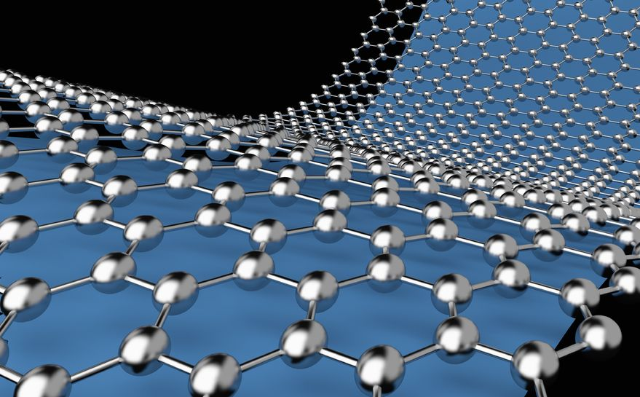
Graphene-based polymer composites
Graphene-based polymer composites show superior mechanical, thermal, gas barrier, electrical and flame retardant properties, compared to the neat polymer

Slide 7
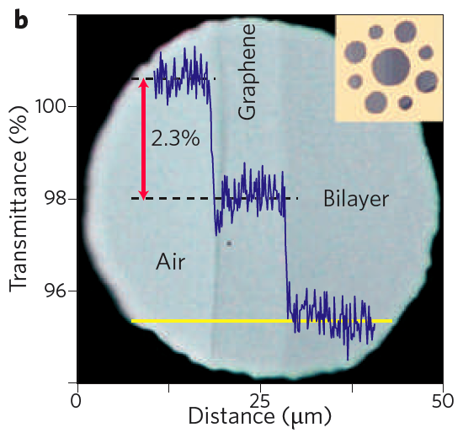
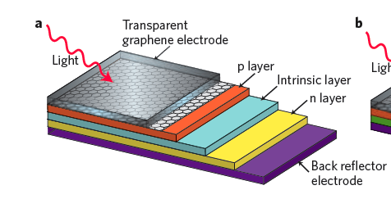
Graphene may be used as a transparent electrode

Slide 8
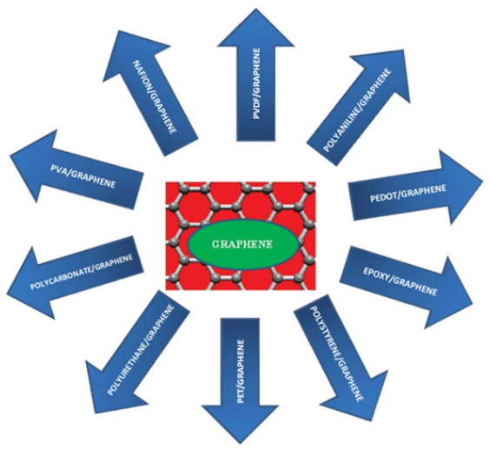
Graphene- polymer composites

Slide 9
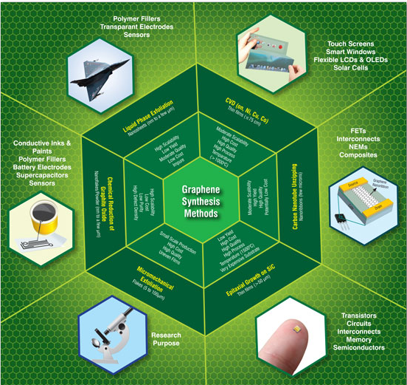
Applications of Graphene

Slide 10
Nano characterization techniques
• Spectroscopy – UV-Vis, Surface enhanced Raman scattering,
X-ray photoelectron spectroscopy
• Microscopic techniques – Optical microscopes
Electron microscopes
Scanning probe microscopes

Slide 11
Electron Probe Characterization Techniques
Acronym | Technique | Utility
SEM | Scanning electron microscopy | Raster imaging/topology morphology
TEM | Transmission electron microscopy | Imaging/particle size-shape
HRTEM | High-resolution transmission electron microscopy | Imaging structure chemical analysis
STEM | Scanning transmission electron microscopy | Biological samples
LEED | Low-energy electron diffraction | Surface/adsorbate bonding
EELS | Electron energy loss spectroscopy | Inelastic electron interactions
AES | Auger electron spectroscopy | Chemical surface analysis
EPMA | Electron probe microanalysis | Particle size/local chemical analysis

Slide 12
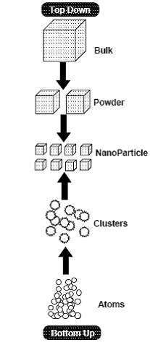
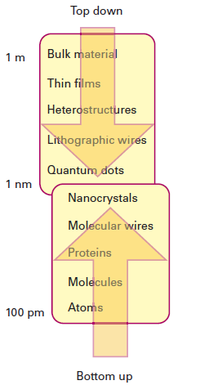
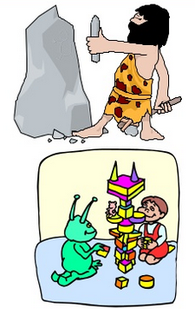
Synthesis of nanomaterials
1. top-down
2. bottom-up
Figure: Two techniques for making nanoscale structures The top-down and the bottom-up

Slide 13

Bottom up approach
These seek to arrange smaller components into more
complex assemblies
Use chemical or physical forces operating at the nanoscale to assemble basic units into larger structures
examples :
1. Indiun gallium arsenide(InGaAs) quantum dots can be
formed by growing thin layers of InGaAs on GaAs
2. Formation of carbon nanotubes

Slide 14
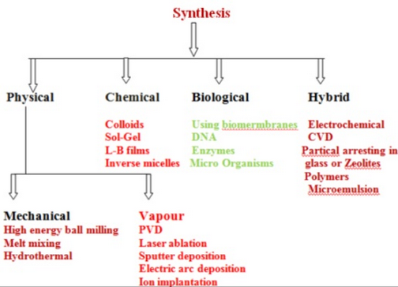
Different approach to synthesize Nanomaterials

Slide 15
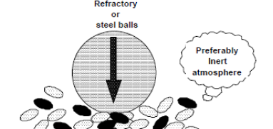
Mechanical grinding
Example of ‘top down’ method of synthesis of nanomaterials
Material is prepared not by cluster assembly but structural decomposition of coarser-grained structures as the result of severe plastic deformation
Advantage: the possibility for easily scaling up to tonnage quantities of material for various applications

Slide 16
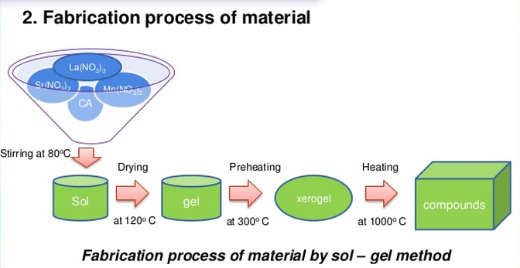
Sol-gel Method of synthesizing nanoparticles
Bottom up method: consisting of sol-gel method, precipitation etc
Sol-gel process: involves the evolution of inorganic networks through the formation of a colloidal suspension (sol) and gelation of the sol to form a network in a continuous liquid phase (gel)
Sol-gel processing refers to the hydrolysis and condensation of metal alkoxide-based precursors such as Si(OEt)₄ (tetraethyl orthosilicate, or TEOS)
MOR + H2O → MOH + ROH (hydrolysis)
MOH + ROM → M-O-M + ROH (condensation)

Slide 17
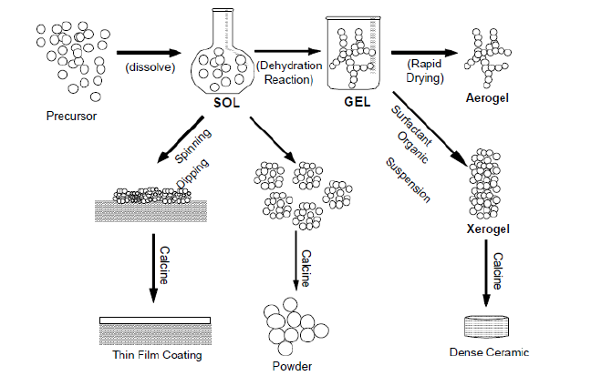
Sol-gel Method of synthesizing nanoparticles
1.Formation of different stable solutions of the alkoxide or solvated metal precursor
2. Formation of an oxide- or alcohol-
bridged network
3. Aging of the gel (Syneresis)
4. Drying of the gel
5. Dehydration
6. Densification and decomposition of
the gels at high temperature
Schematic representation of sol-gel process of synthesis of nanomaterials
Possible to synthesize nanoparticles, nanorods, nanotubes etc from this method

Slide 18
Advantages of Sol-gel technology
Excellent stoichiometry control of precursor solutions,
Ease of compositional modifications, customizable
microstructure
Ease of introducing various functional groups or encapsulating sensing elements, relatively low annealing temperatures, the possibility of coating deposition on large-area substrates
Simple and inexpensive equipment

Slide 19
Examples of Sol-Gel powders
Sol-gel Barium Titanate
Titanium tetra-isopropoxide
Ti(OC₃H₇)₄
Acetic Acid
Titanium precursor
Barium acetate (aqueous solution)
Gelation
Chemical Polymerization
Drying and Calcination
BaTiO₃ powders

Slide 20
Gas phase synthesis
Methods using liquid or vapor precursors
Chemical Vapor Deposition
Spray Pyrolysis
Laser Pyrolysis/ Photochemical Synthesis
Thermal Plasma Synthesis
Flame Synthesis
Plasma Synthesis
Low-Temperature Reactive Synthesis
Methods using solid precursors
Inert Gas Condensation
Pulsed Laser Ablation
Spark Discharge Generation
Ion Sputtering

Slide 21
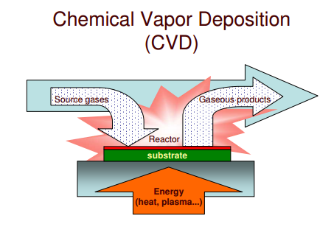
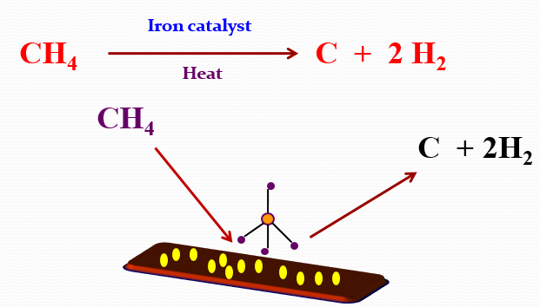
Vapour-phase synthesis of nanoparticles
Chemical Vapor Deposition (CVD) method: vapor is formed in a reaction chamber by pyrolysis, reduction, oxidation or nitration, and then deposited on the surface
Areas of growth are controlled by patterning processes like photolithography or photomasking (deposition patterns are etched on to the surface layers of the wafers)
Production of thin films
carbon nanotubes

Slide 22

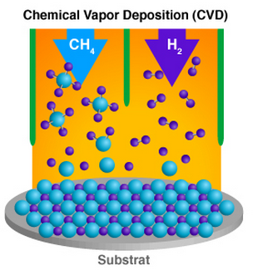
Chemical Vapor Deposition (CVD) method
Chemical decomposition of the feed molecules proceeds upstream of a substrate surface on which the desired product will be grown
Decomposition of the gaseous reactants is activated by high temperatures, lasers, or plasma
Ex: Group 13/15 (III/V) semiconductors

Slide 23
Advantages of CVD synthesis of nanoparticles
CVD is used to grow a thin layer of advanced materials on the surface of a substrate
MOCVD (metal/organic CVD)and MBE (molecular beam epitaxy) have been combined to allow for in situ monitoring of growth which is called chemical beam epitaxy (CBE)
Applications: integrated circuits, optoelectronic devices and sensors, catalysts, micromachines, and fine metal and ceramic powders protective coatings

Slide 24
Summary
Graphene-based polymer composites show superior mechanical, thermal, gas barrier, electrical and flame retardant properties
Two approaches for synthesis of nano materials and the fabrication of nano structures: top down and bottom up
CVD is a chemical process used to produce high quality, high-performance, solid materials
Application of graphene- polymer nanocomposite

